Slide 1

Advanced Programming 2
FlightGear Controller App
Yahav Zarfati

Slide 2
Lets get into details…
Presented and made by Yahav Zarfati(06/2021).
Advanced Programming 2 course (8921101) – Dr. Eliyahu Khalastche.
Faculty of Computer Science, Bar Ilan University.
Github link

Slide 3


Intro
The application is used as a FlightGear Simulator remote controller
Created using Android Studio IDE based on Intellij, also Java.
Requirements:
FlightGear Simulator(2020.3.6 or above).
Min Version: Android 10 OS. (Tested ver. – Pixel 3a API 29)

Slide 4
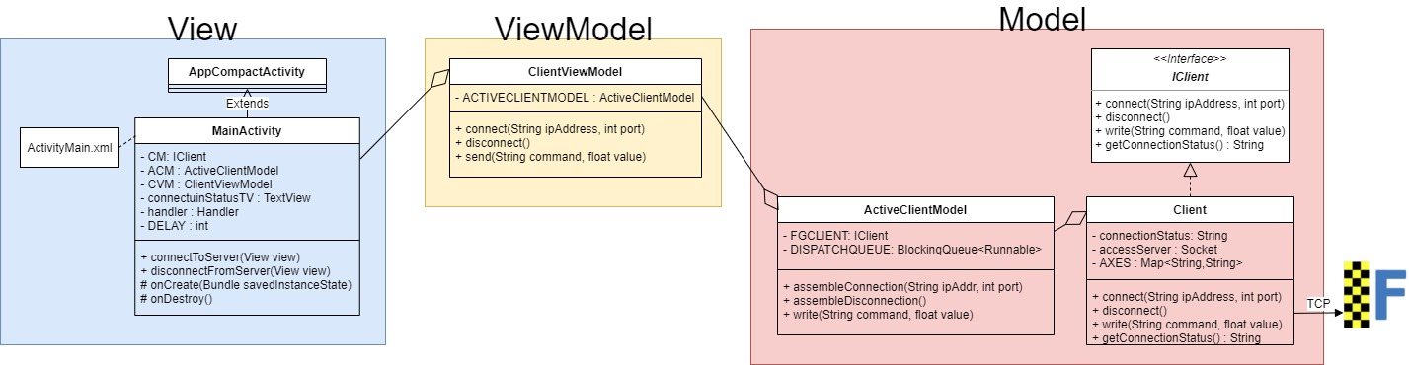
UML – MVVM architectural pattern

Slide 5
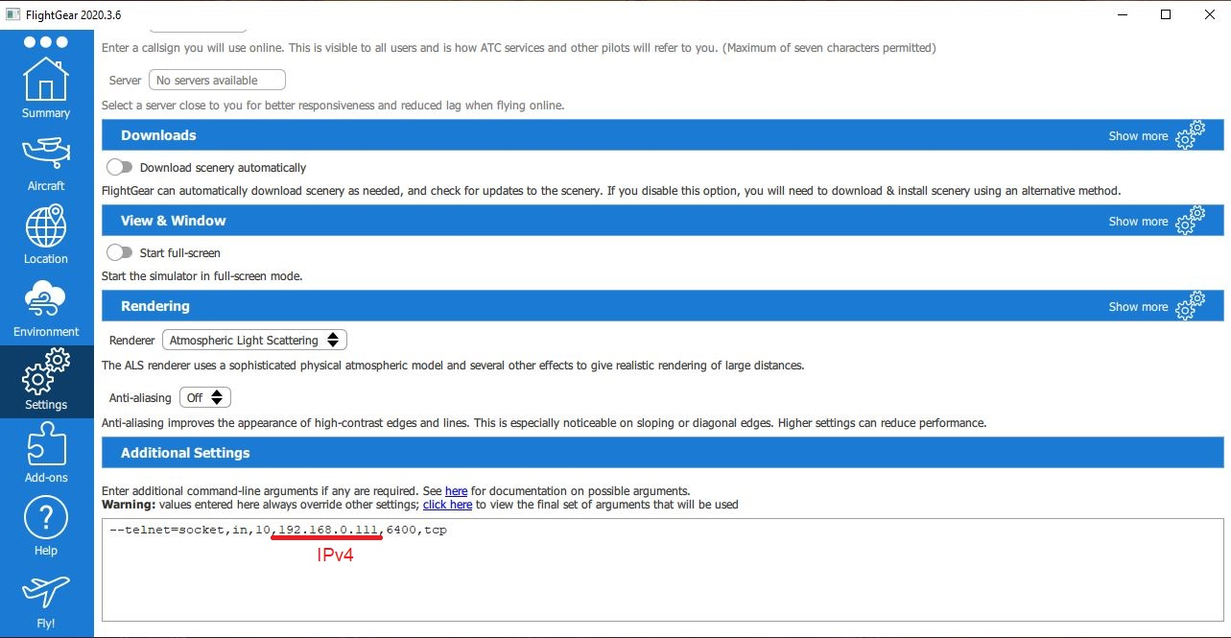
How do I start flying?!
1.Copy this line into your FG, don’t forget to change your IPv4 Address
2.Hit Fly! And start flying

Slide 6
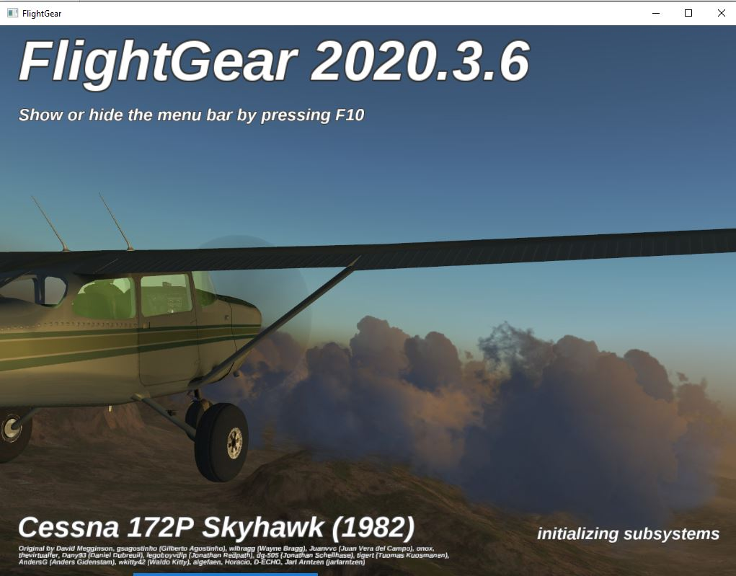
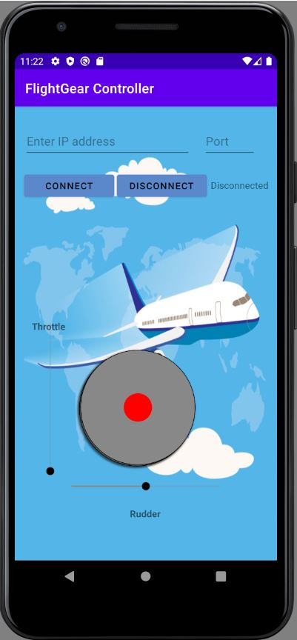
Lets give it a try
My demo!

